Slide 1
PARKING OF A MOBILE ROBOT USING MODELING LANGUAGES
Muntean Maria
Lucian Blaga University of Sibiu
maria.muntean@ulbsibiu.ro

Slide 2
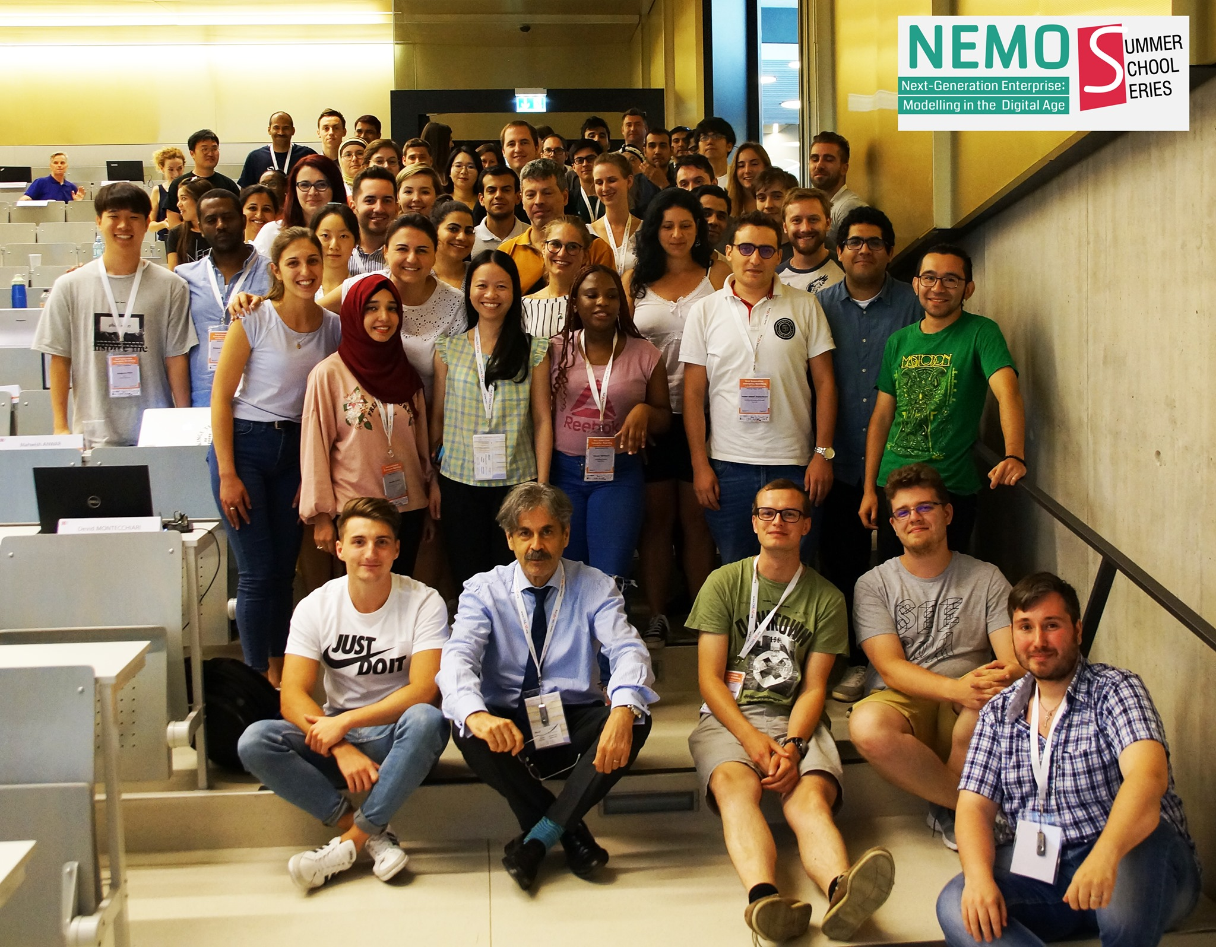
Motivation
“We use abstraction to reduce complexity in a domain for a specific purpose!”
Dimitris Karagiannis

Slide 3
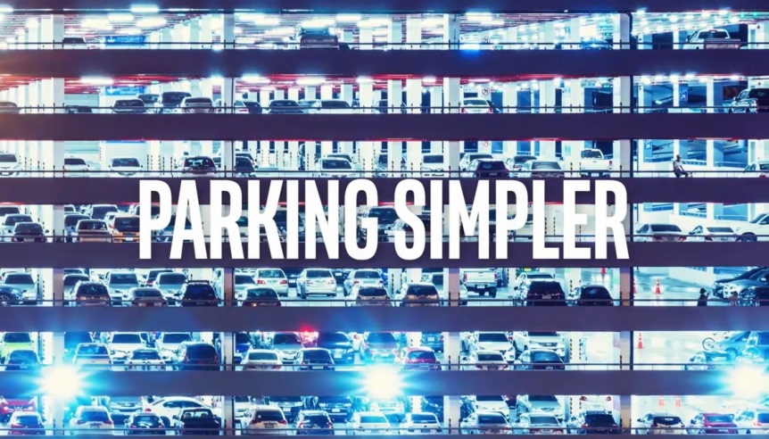
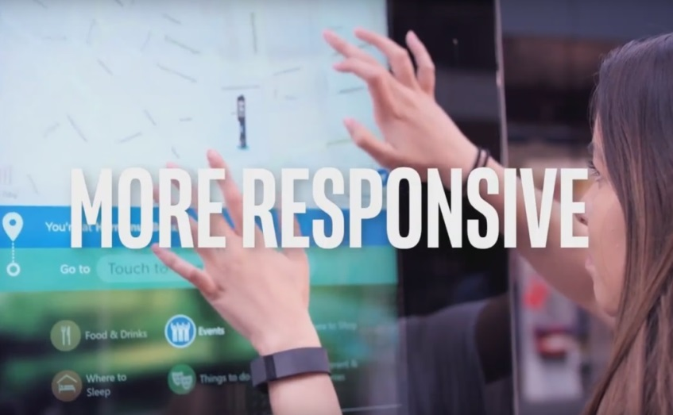
The advantages of smart parking systems
Creating a Hardware-Software application for:
Streamlining traffic especially at peak hours
Reducing search time for a parking space
Reducing fuel cost with search for a parking space =>
reducing pollution and improving air quality.
Notes:
Am ales această temă deoarece găsirea unui loc de parcare reprezintă una dintre cele mai mari probleme ale unui șofer. Calitatea aerului este tot mai slabă, asta și datorită traficului intens și modurilor ineficiente de transport.
Astfel, aceste probleme pot fi reduse prin implementarea unui sistem de parcare eficient.

Slide 4
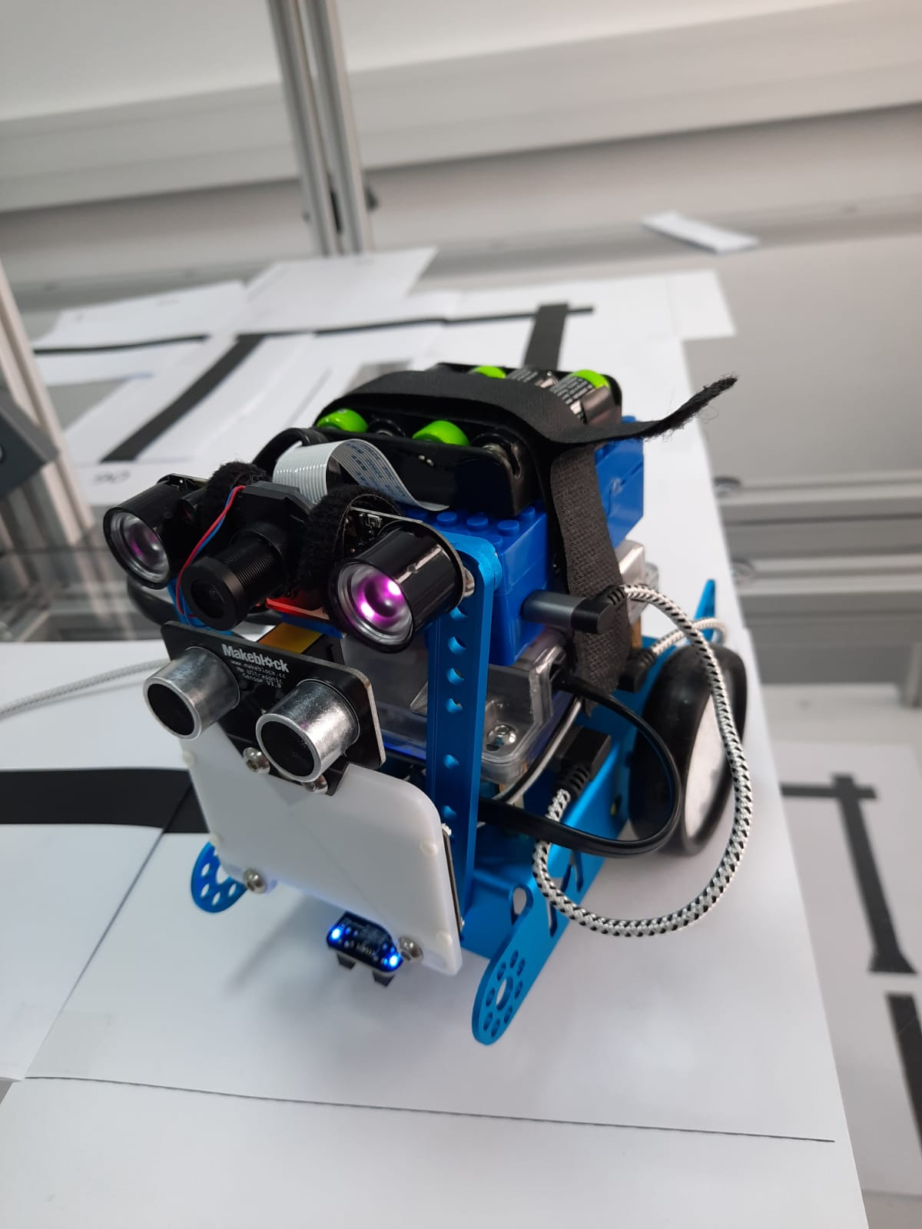
Purposes
To model the Mobile Robot to park at a specific place, and also at the first parking space it finds available.
01
02
To use the modeling languages.
To use the suit of modeling tools provided by the University of Vienna.
03

Slide 5
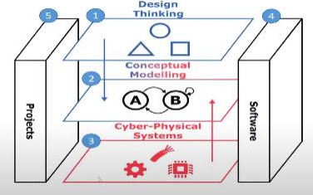
Used Approach
2 SCENARIOS

Slide 6
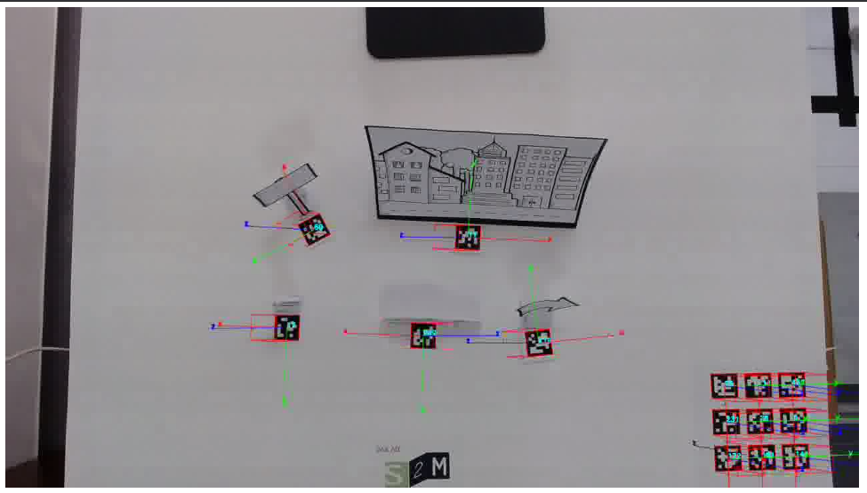
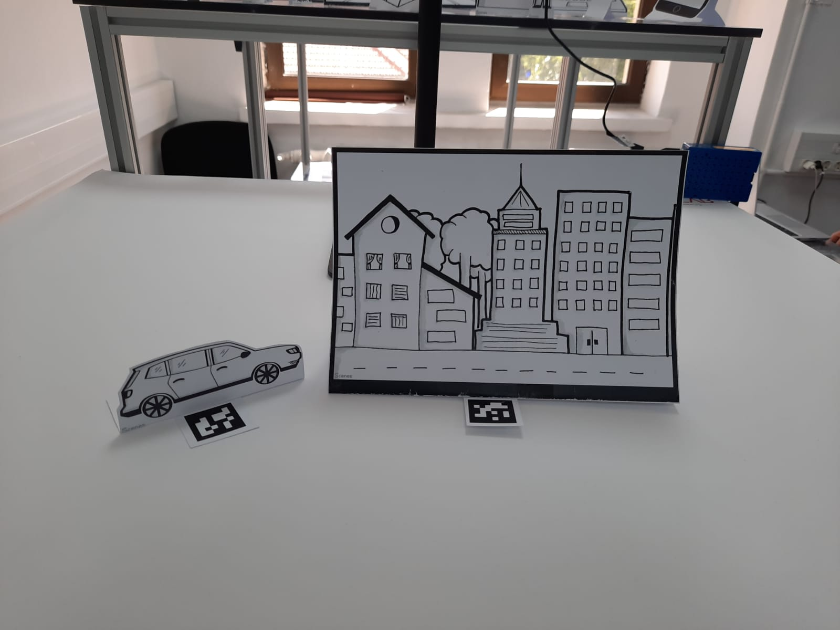
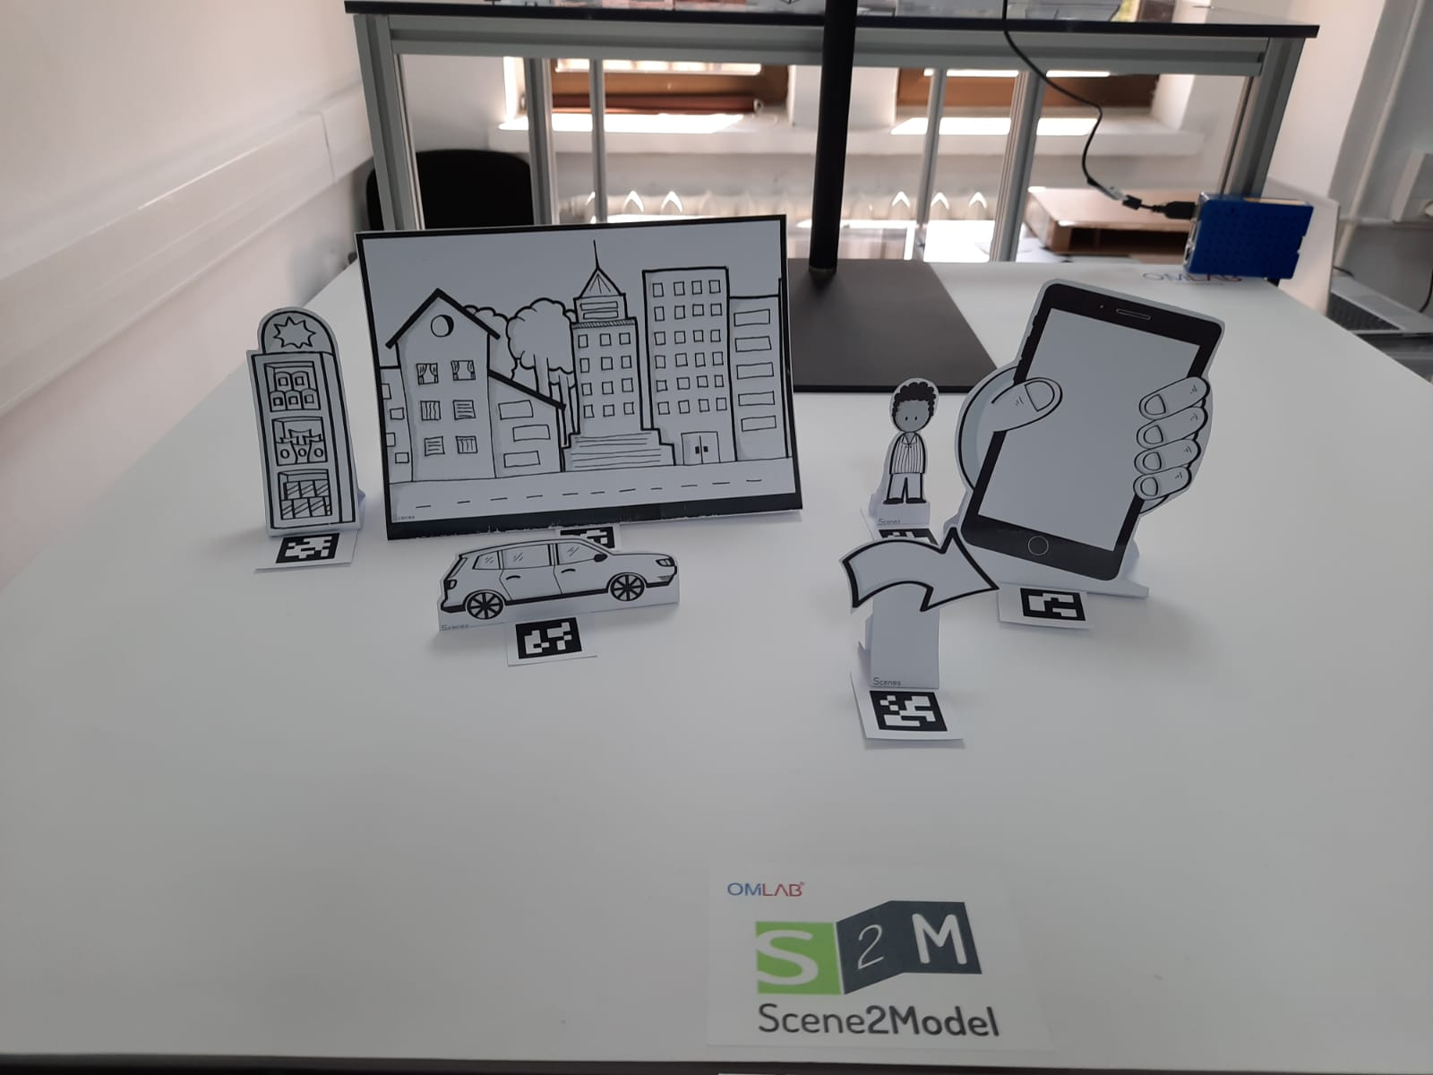
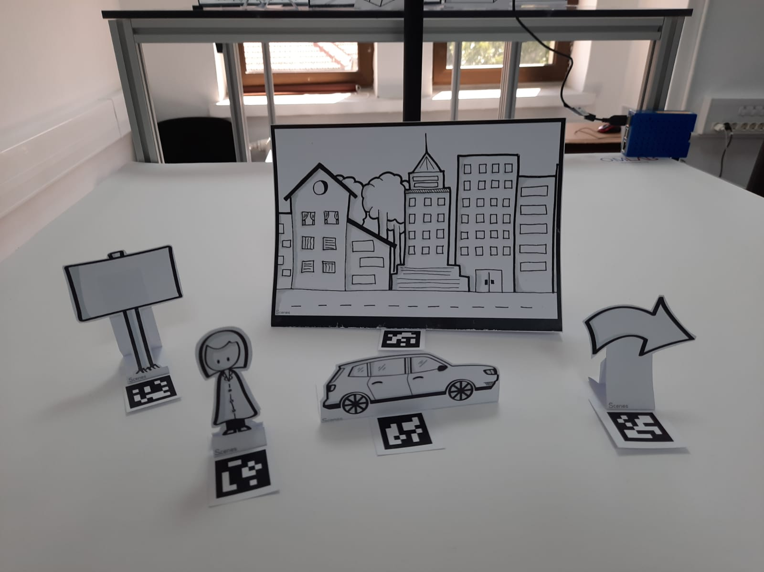
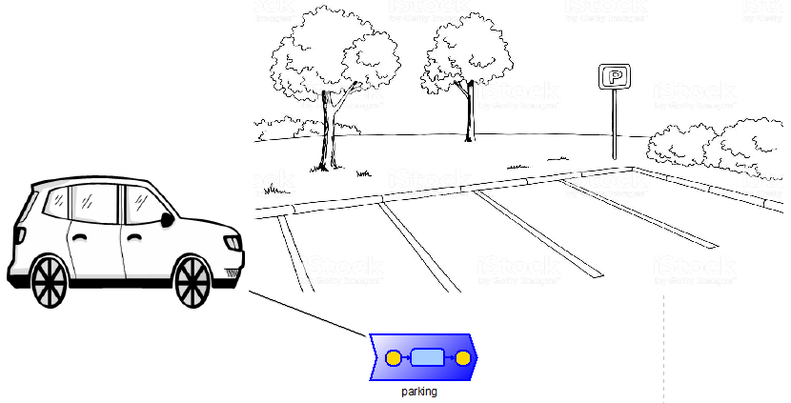
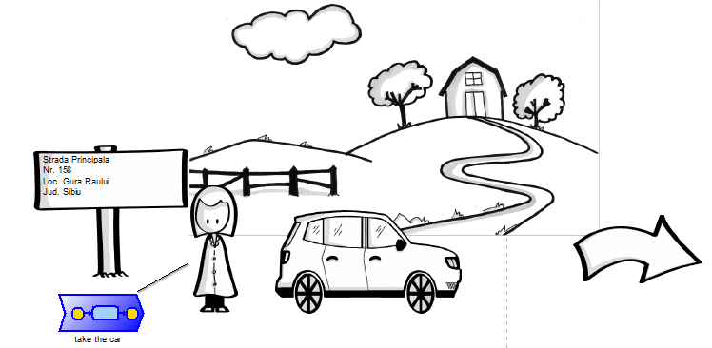
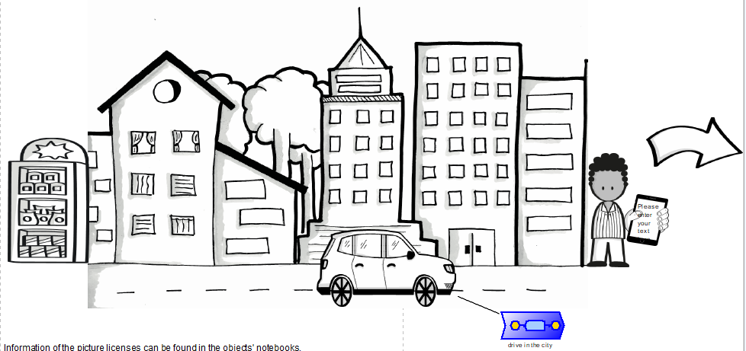
Design Thinking

Slide 7
Scene 1: Get the car
Scene 2: Drive to the city
Scene 3: Park the car

Slide 8
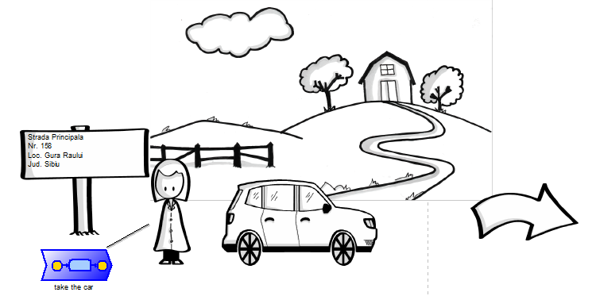
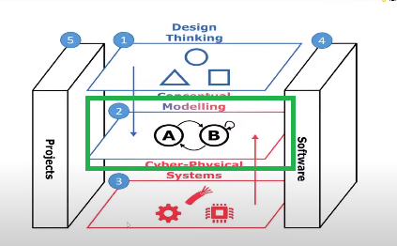
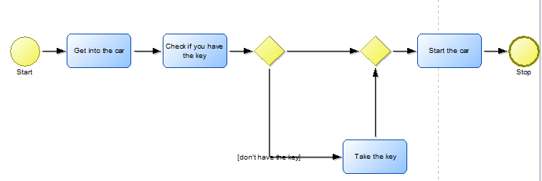
Conceptual Modeling

Slide 9
Story Board

Slide 10
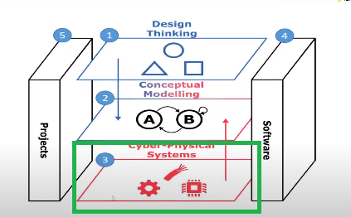
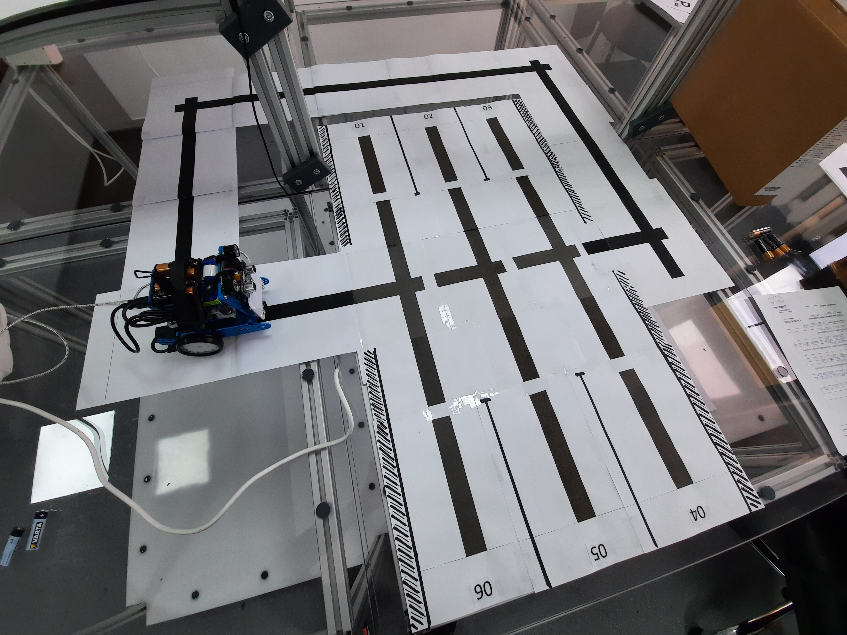
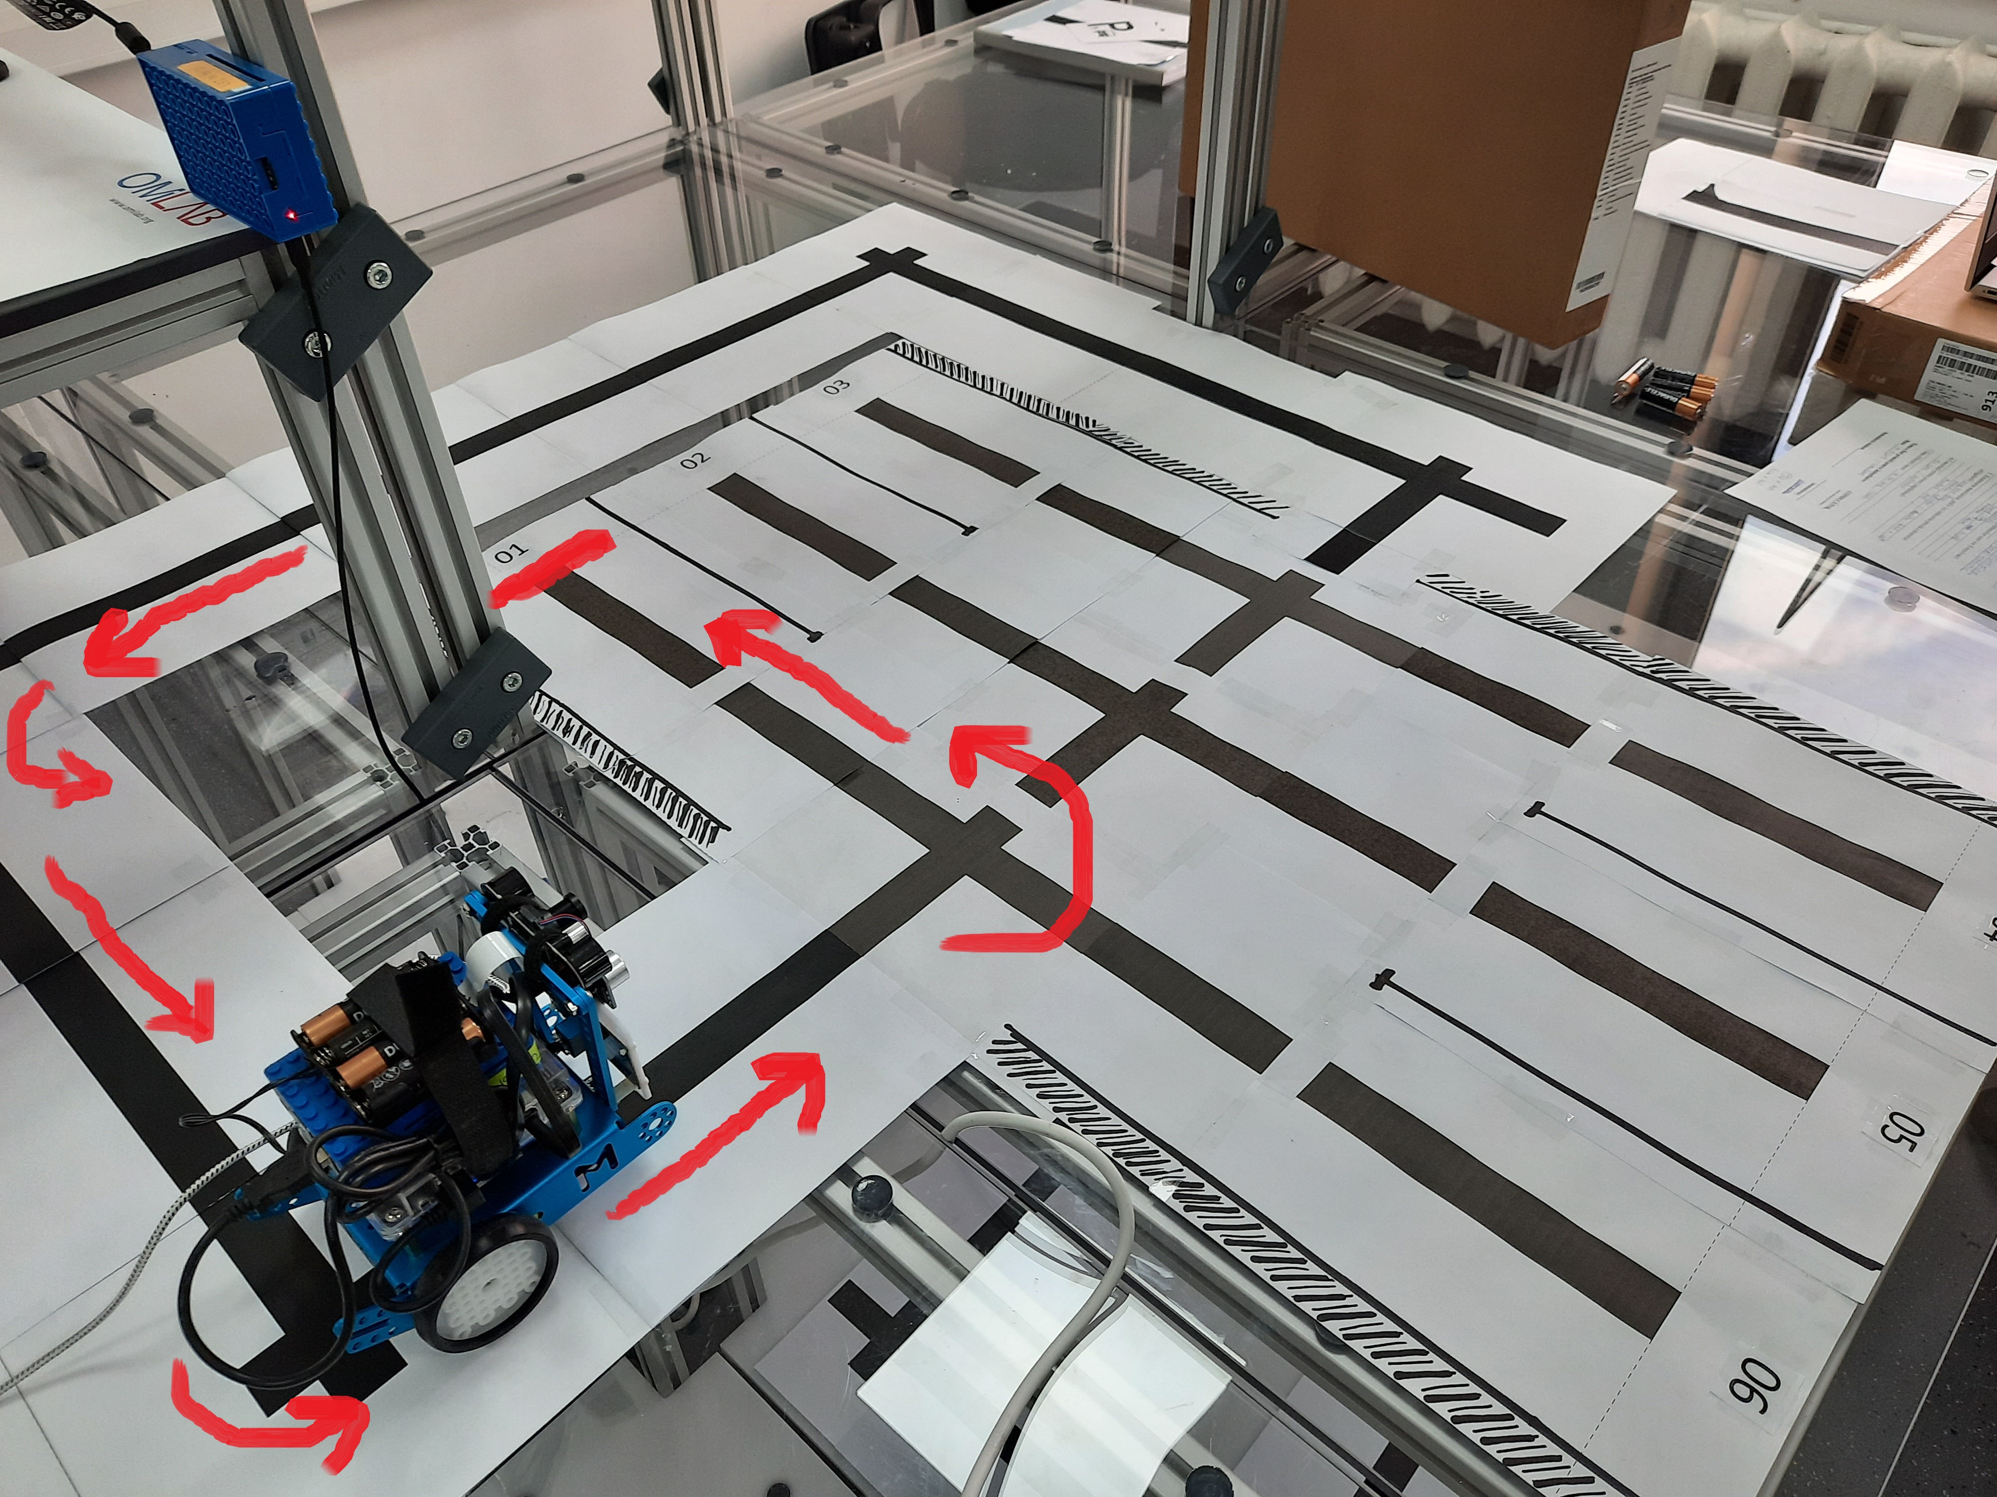
Cyber Physical System

Slide 11
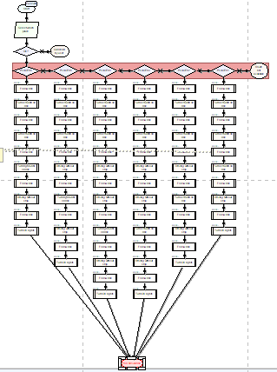
First Scenario
The Mobile Robot goes to a fixed location, chosen by the user.
Using FlowCharts diagrams
Using ADOScript code
HTTP_SEND_REQUEST calls

Slide 12
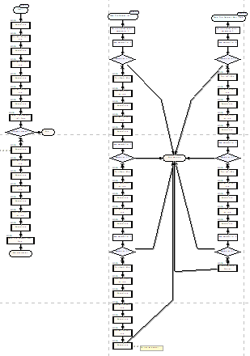
Second Scenario
The Mobile Robot decides for itself where to go using the external components which are included on the robot.
Using FlowChart diagrams
Use of branch structures
ADOScript code more complex than the previous model

Slide 13
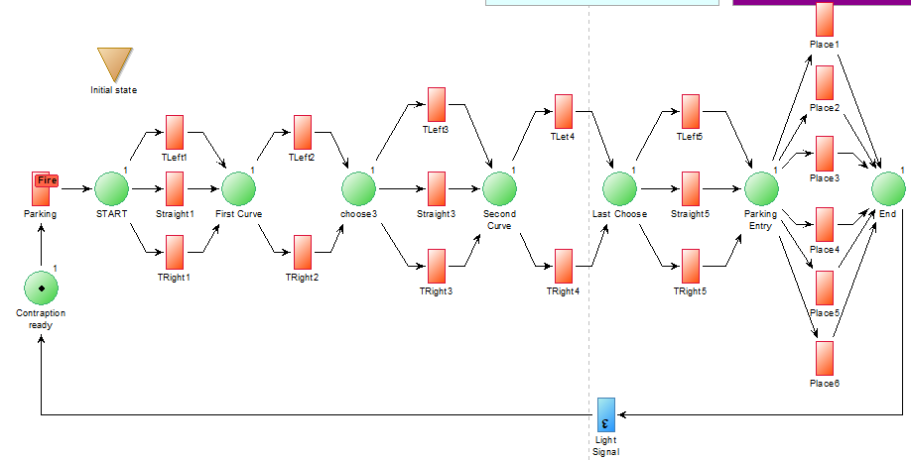
First Scenario – Petri Net
Is the same scenario like presented above but modeled using a different modeling language from those provided.
Using PetriNet modeling language
Using ADOScript commands

Slide 14
Conclusions and further developments
Conclusions:
Making the scenario is easy
No programming knowledge required
Any scenario can be realized, in any field
Freedom to choose the language of modeling
Regarding further developments:
Creating a new scenario using the camera attached to Mobile Robot to recognize traffic signs and pedestrians (add Computer Vision and Machine Learning Algorithms)
Addition of new proximity sensors to achieve obstacle avoidance scenarios
Improving current scenarios by adding the new sensors

Slide 15
References
Dimitris Karagiannis, Heinrich C. Mayr, John Mylopoulos – “Domain-Specific Conceptual Modeling”
Scene2Model Tool : https://austria.omilab.org/psm/content/scene2model/info
Bee-Up Tool : https://austria.omilab.org/psm/content/bee-up/info
ADOxx : https://www.adoxx.org/live/home
OMiLAB Approach : https://www.omilab.org/assets/docs/OMiLAB%20Laboratory%20Layout_DRAFT.pdf

Slide 16
Thank you for your attention!

